Slide 1
Guided Capstone Project
Big Mountain Resort

Slide 2
Problem identification
Capitalize Big Mountain facilities as much as possible.
Find the optimal pricing strategy considering:
changes that would cut costs
1 additional chair lift, totaling 12 lifts, to increase distribution of visitors increasing operating costs increased by $1,540,000 this season
without undermining the ticket price
or would support an even higher ticker price.

Slide 3
Problem identification
We do have adult ticket prices (weekday & weekend)
But we do not have children or any other type of ticket prices.
Every year 350,000 people ski or snowboard at Big Mountain
But we do not have neither the past nor the projected number of customers at all the 330 resorts in the US.
We do not have the total operating costs.
Data: region, state, elevation, drops, trams, chairs (fast & regular), runs, longest run, terrain parks, skiable area, snow making area, average snow fall, night skiing area, days open last year, years open, projected days open, ticket prices (weekday & weekend)

Slide 4
Recommendation and key findings
The validity of our model lies in the assumption that other resorts accurately set their prices according to what the market (the ticket-buying public) supports. The fact that our resort seems to be charging that much less that what's predicted suggests our resort might be undercharging. But if ours is mispricing itself, are others? It's reasonable to expect that some resorts will be "overpriced" and some "underpriced." Or if resorts are pretty good at pricing strategies, it could be that our model is simply lacking some key data? Certainly, we know nothing about operating costs, for example, and they would surely help.

Slide 5
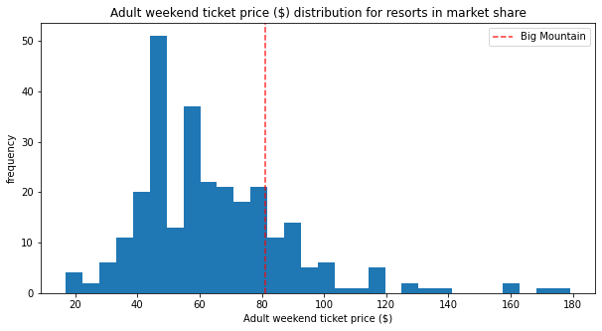
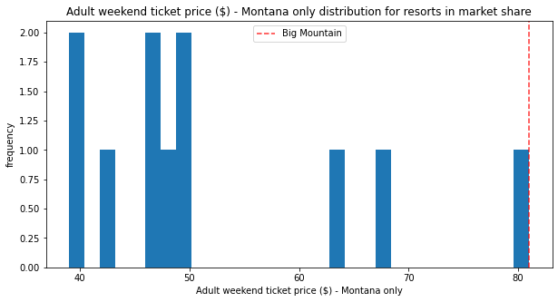
Modeling results and analysis
Modelled price is $98.07, even with the expected mean absolute error of $10.46, this suggests there is room for an increase.
1 Ticket price
Look at where Big Mountain sits overall amongst all resorts for price and for just other resorts in Montana.

Slide 6
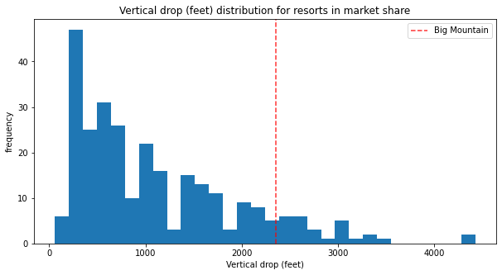
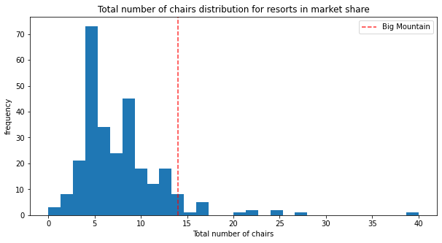
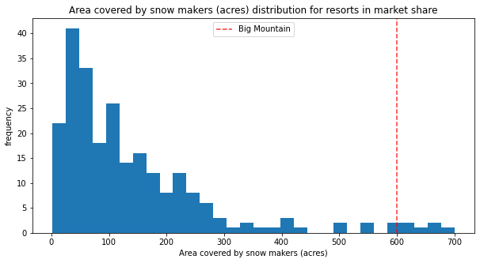
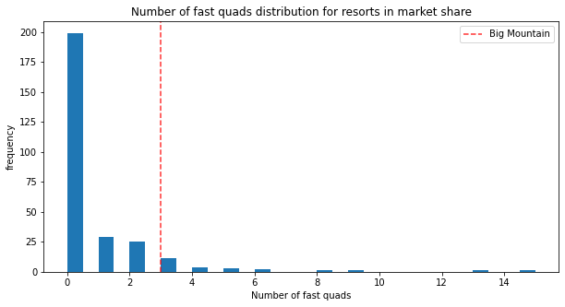
2 Vertical drop
Big Mountain is doing well for vertical drop, but there are still quite a few resorts with a greater drop.
4 Total number of chairs
Big Mountain has amongst the highest number of total chairs, resorts with more appear to be outliers.
3 Snow making area
Big Mountain is very high up the league table of snow making area.
5 Fast quads
Most resorts have no fast quads. Big Mountain has 3, which puts it high up that league table. There are some values much higher, but they are rare.

Slide 7
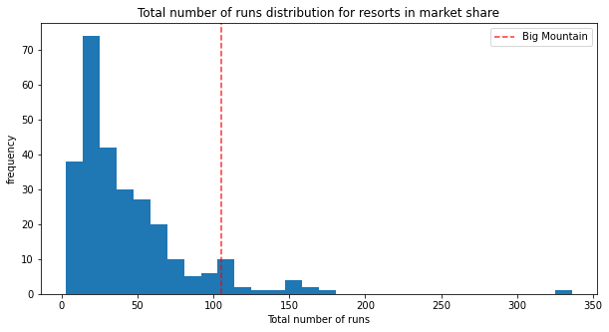
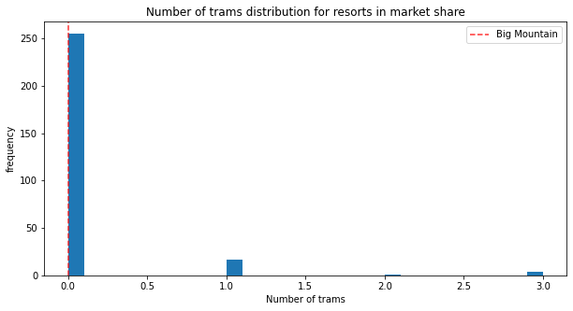
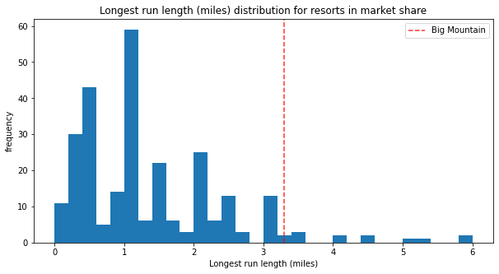
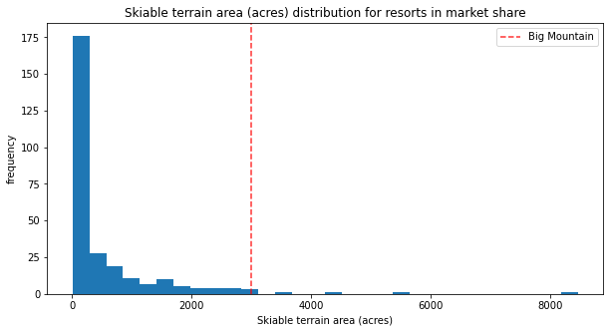
6 Runs
Big Mountain compares well for the number of runs. There are some resorts with more, but not many.
8 Trams
The vast majority of resorts, such as Big Mountain, have no trams.
7 Longest run
Big Mountain has one of the longest runs. Although it is just over half the length of the longest, the longer ones are rare.
9 Skiable terrain area
Big Mountain is amongst the resorts with the largest amount of skiable terrain.

Slide 8
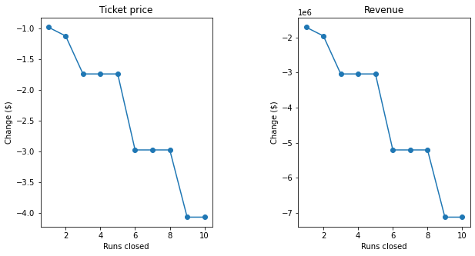
Scenarios
Scenario 1: Close up to 10 of the least used runs. The number of runs is the only parameter varying.
Scenario 2: In this scenario, Big Mountain is adding a run, increasing the vertical drop by 150 feet, and installing an additional chair lift. This scenario increases support for ticket price by $1.55. Over the season, this could be expected to amount to $2’708,333
Scenario 3: In this scenario, you are repeating the previous one but adding 2 acres of snow making. This scenario increases support for ticket price by $1.55. Over the season, this could be expected to amount to $2’708,333. Such a small increase in the snow making area makes no difference!
Scenario 4: This scenario calls for increasing the longest run by .2 miles and guaranteeing its snow coverage by adding 4 acres of snow making capability. No difference whatsoever. Although the longest run feature was used in the linear model, the random forest model (the one we chose because of its better performance) only has longest runway down in the feature importance list.
The model says closing one run makes no difference. Closing 2 and 3 successively reduces support for ticket price and so revenue. If Big Mountain closes down 3 runs, it seems they may as well close down 4 or 5 as there's no further loss in ticket price. Increasing the closures down to 6 or more leads to a large drop.

Slide 9
Summary and conclusion
Close 1 run since it would make no difference in the revenue, but it will reduce operational cost: then profit will be increased.
Create a new run, increasing vertical drop 150 feet, installing additional chair lift: ticket +$1.55 (season +$2’708,333)
Add 2 acres of snow making: ticket +$1.55 (season +$2’708,333)
Do not increase the longest run by .2 miles or guaranteeing its snow coverage by adding 4 acres of snow making capability since it does not generate revenue increment.

